Slide 1


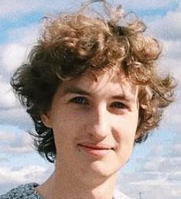


TrackOut
Future of Fitness

Slide 2
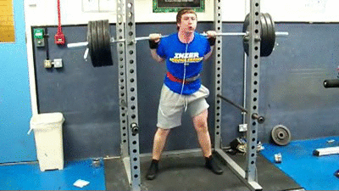
Workout Injuries
500 000
14%
~$100
Injuries in 2012
Due to Bad Form
Per Hour for Trainer

Slide 3

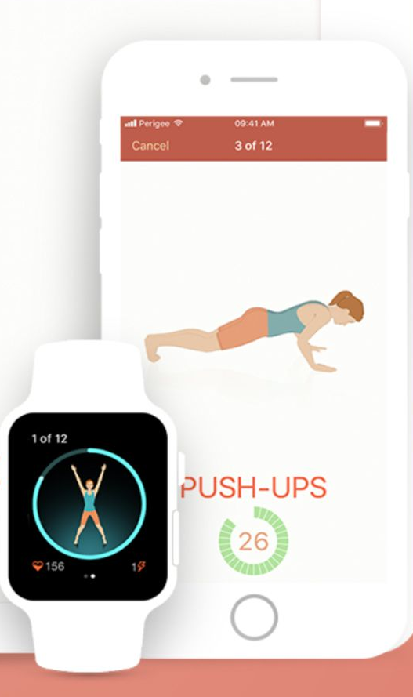

Today’s solutions
Notes:
No feedback, expensive, no structure

Slide 4
TrackOut
Welcome
Are you ready to
TrackOut

Slide 5
The TrackOut Advantage
Feedback
Real-Time
Meaningful
Improved Form
Reduced Injury
Effective Excercise
Consistency
Structured
Scheduled

Slide 6



Awesome Features
Tracked
Workouts
Smart
Scheduling
Shared Community

Slide 7

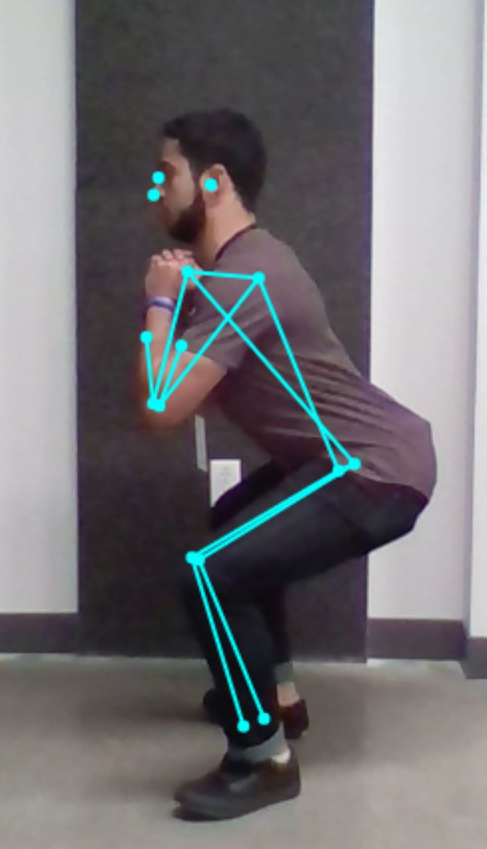
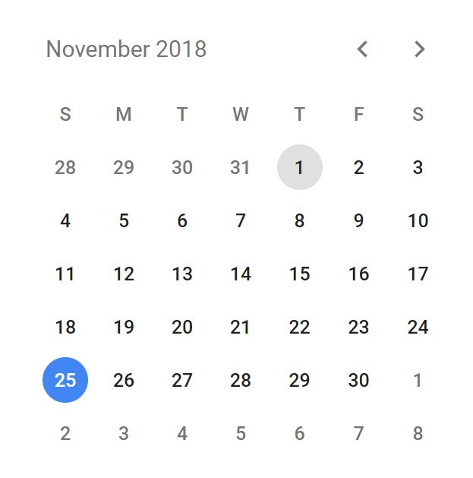
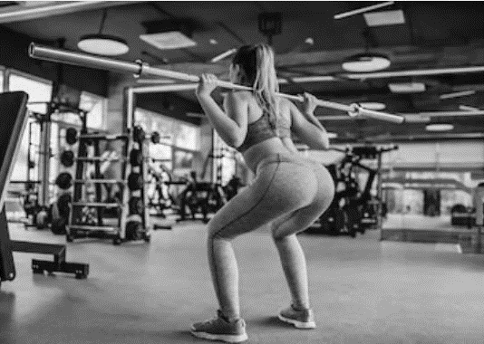
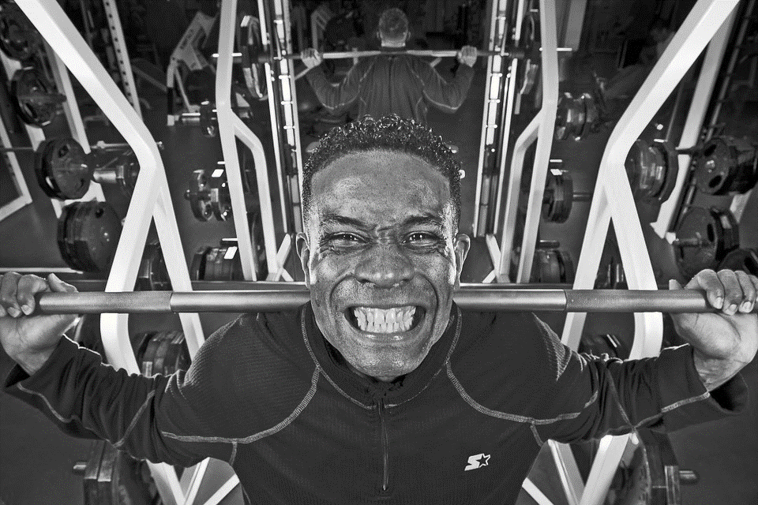
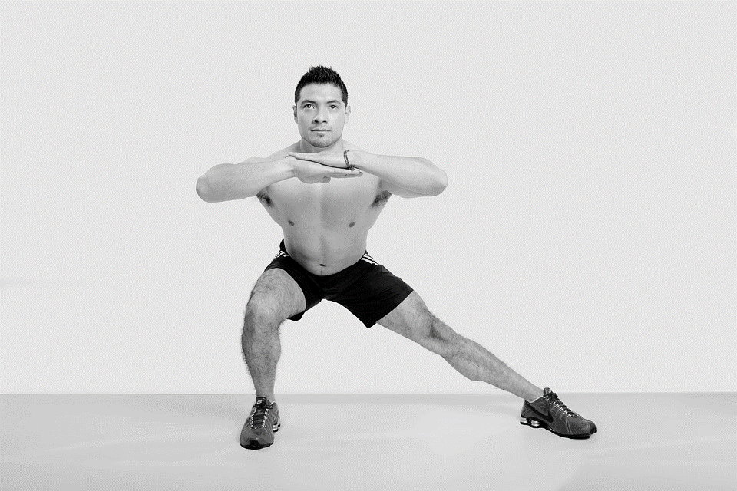



Workouts
87%
7/10
Schedule
Squats
Deadlifts
Lunges
Almost there!
14
Done
78%
Form
3 Day
Streak

Slide 8




Future Plans
Bitmoji Integration
Creative Workouts
Gym Implementation
Community Engagement+
Collaboration with Influencers

